Slide 1
Digital DFT and scan Design
Test & reliability
Patrice Delpy 2017

Slide 2
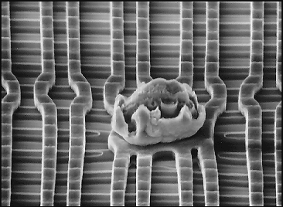
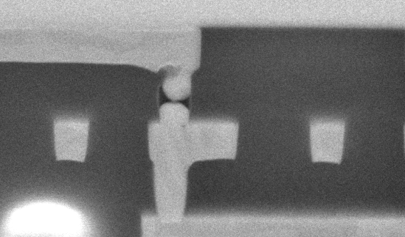
Circuit ouvert
Court circuit

Slide 3
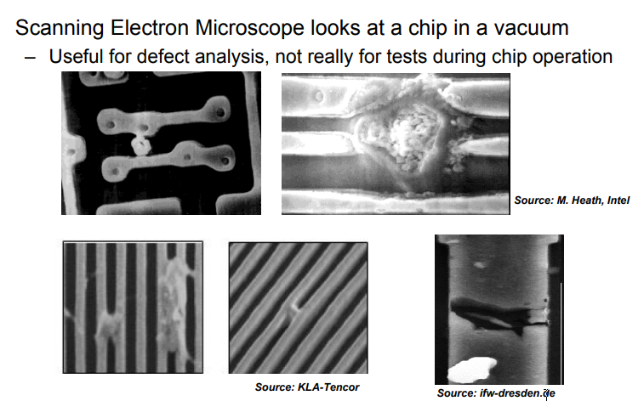

Slide 4
Murphy's laws
“If you don’t test it, it won’t work!” (Guaranteed)

Slide 5
Importance of Testing
Decreasing feature size increases probability of defects during manufacturing process
Improve yield and reject indesirable parts
2 types of yield loss
Random effects or porcess variations

Slide 6
Test generation
A test is a sequence of test patterns caller test vectors applied to tge DUT whose outputs are monitored and analayzer for the correct response
Fault coverage is a quantitative measure of quality of a set of test vectors

Slide 7
Defects in fabrication
In the fabrication of chips, there are defects that get introduced. These defects come from many sources:
1. Defects in the base silicon.
2. Dust or contamination in the fab or on wafer.
3. Dust on mask.
4. Misalignment.
5. Over-etch or under-etch.
…….

Slide 8
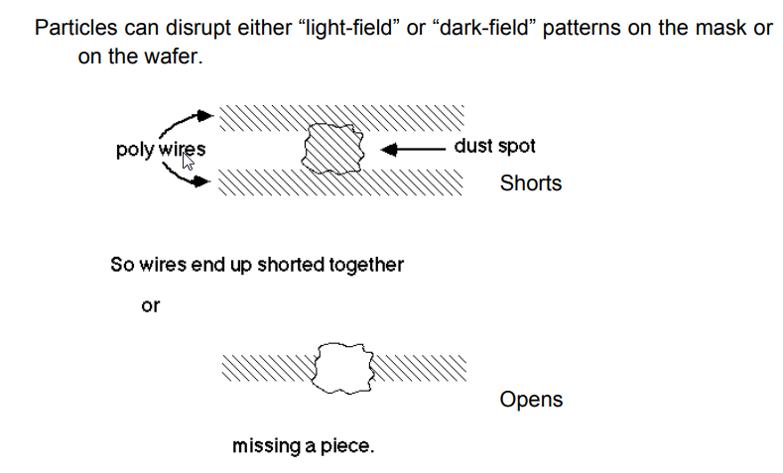
Particule defects
Production Testing
• Defects are random, they can occur anywhere on the chip.
• Need to check every unique instance (every transistor and every wire)

Slide 9
IDDQ Testing
Measuring the quiescent power supply current (IDDQ) as a method of testing circuits.
So, measuring IDDQ is a great way to detect shorts which will cause fighting output drivers to consume current.

Slide 10
Stucks at faults
Transistor faults
Short and opens
Bridging faults
Delays faults and crosstalk
Sensitivity and coupling faults

Slide 11
Test
Can tests that detect all faults assured?
Can test execution time be kept within economical requirement?

Slide 12
Apply scan design to a sequential circuit and develop appropriate test patterns

Slide 13
Design for Test
Design the chip to increase observability and controllability

Slide 14
SCAN
Obtain controllability & observability of FlipFlops
Observability: ease of observing a node by watching external output pins of the chip 
Controllability: ease of forcing a node to 0 or 1 by driving input pins of the chip
Shift register
Testmode implementation

Slide 15
Scan
Additionnals pins to control or observe circuits = scan chains
Observability: you can stop the chip and read out all their states – Controllability: you can stop the chip and set all of their states
=> additional chip area required (15%)

Slide 16
Testing
Testing is one of the most expensive parts of chips
Logic verification accounts for > 50% of design effort for many chips effort for many chips
Debug time after fabrication has enormous opportunity cost opportunity cost
Shipping defective parts can sink a company

Slide 17
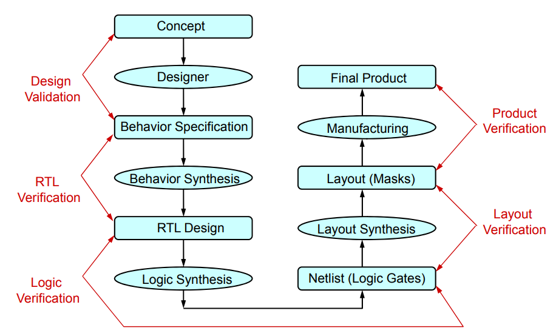
VLSI Design Flow

Slide 18
Role of testing
The fabrication process was faulty
The role of testing is to detect whether something went wrong
Effectiveness of testing is most important for quality products
Quality and economy are two major benefits of testing

Slide 19
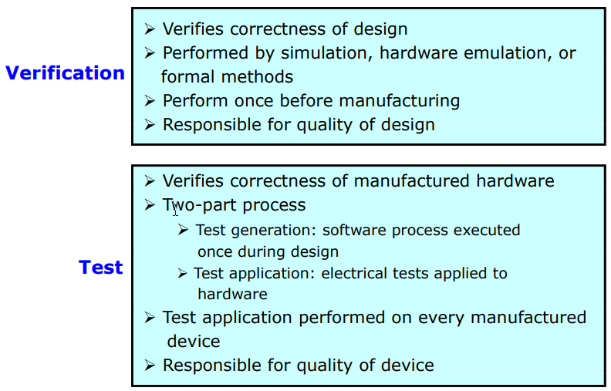
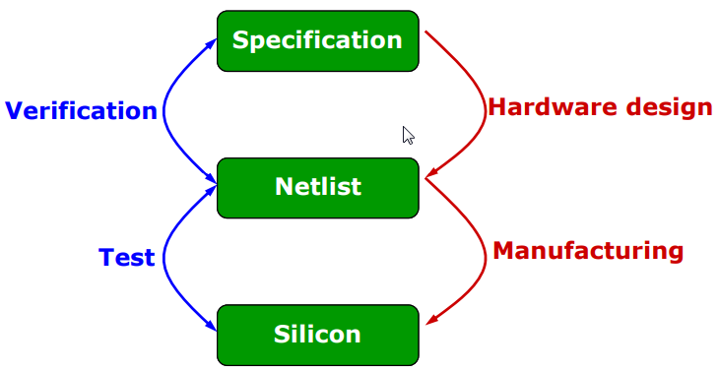
Verification & Test

Slide 20
Defect
A defect is the unintended difference between the implemented hardware and its intended design 
Defects occur either during manufacture or during the use of devices

Slide 21
Typical Types of Defects
Primarily caused by dust particles on the mask or wafer surface, or in the processing chemicals
Oxide breakdown (crystal defects)

Slide 22
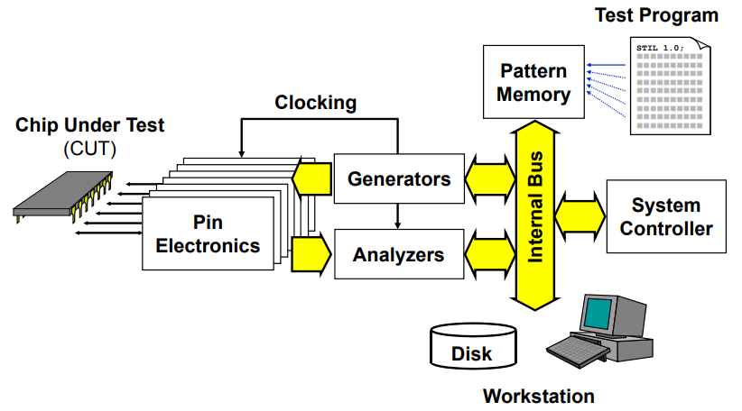
Internal strucure of the ATE

Slide 23
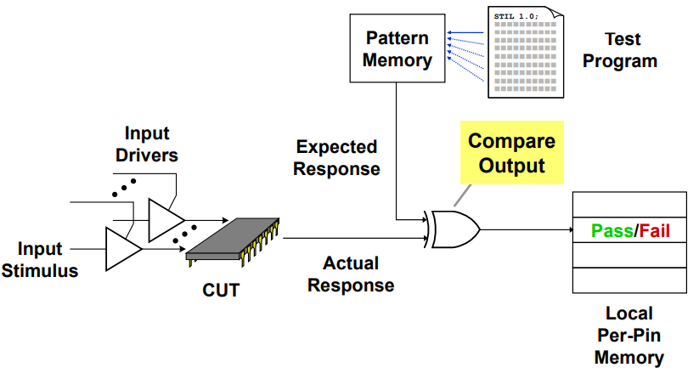
ATE test operation

Slide 24
Fault model
stuck-at fault
The faulty line is permanently set to 0 or 1
Quiescent current IDDQ

Slide 25
Test pattern generation

Slide 26
Test complexity
Manufacturing test ideally would check every node in the circuit to prove it is not stuck. Can’t be exhaustive !Cost time
N inputs = 2N combinations
With 10 tester:
32 inputs = 7 min
40 inputs = 30 hours
…..
Good observability and controllability reduces number of test vectors required for manufacturing test

Slide 27
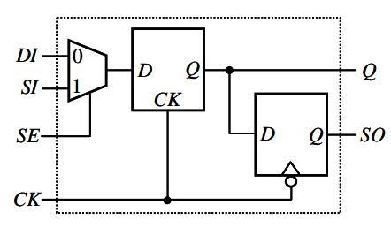
Muxed D scan cell

Slide 28
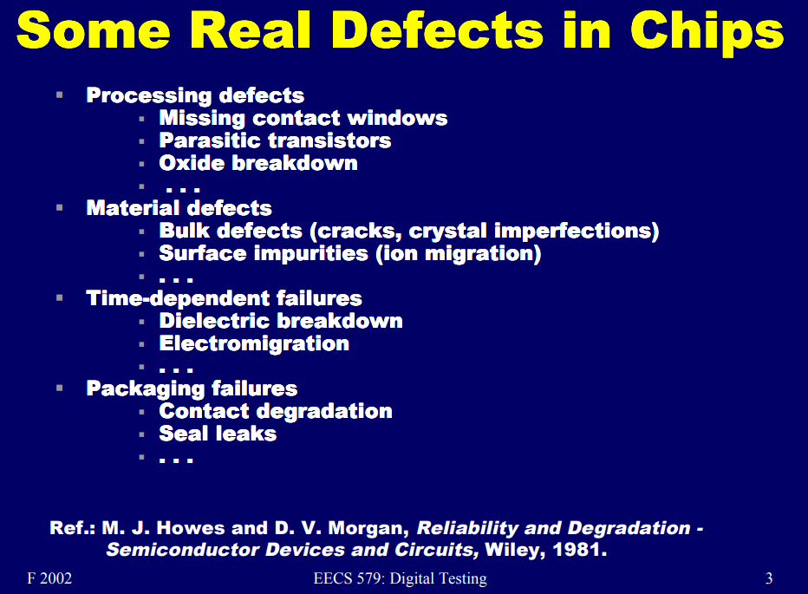

Slide 29
Reasons for IC malfunction
Contamination / Instabilities - Process induced impurities and random fluctuations of process conditions  Defects - Permanent deformation in IC layer which may but does not have to result in fault  Faults - Functional misbehaviors i.e. IC malfunctions

Slide 30
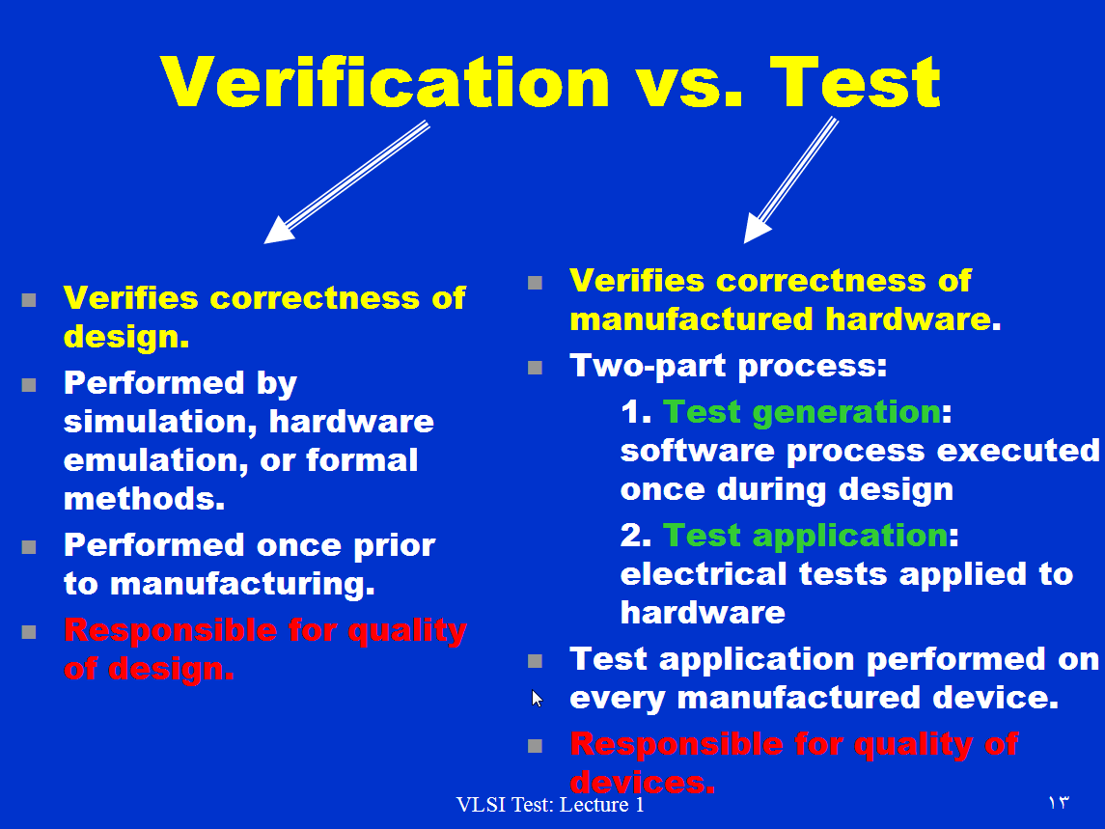

Slide 31
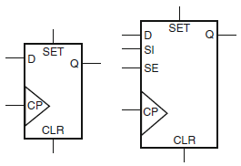
Scan flops
Scan chain
Stitching the chain
Shift in /out - capture

Slide 32
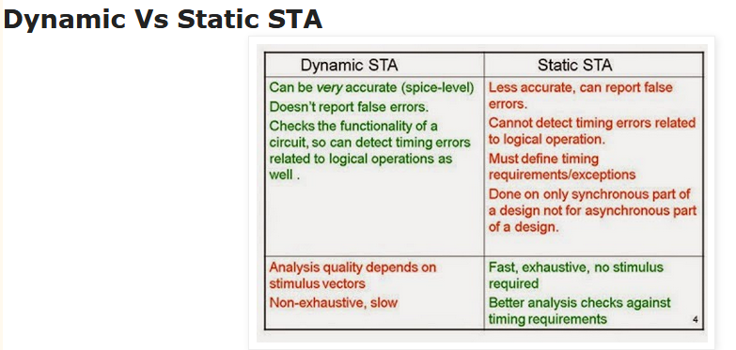
techniques available to verify the timing of a digital design.
STA : violations ?

Slide 33
Timing analysis can be static or dynamic. Dynamic timing analysis verifies functionality of the design by applying input vectors and checking for correct output vectors whereas Static Timing Analysis checks static delay requirements of the circuit without any input or output vectors.

Slide 34
Setup time: input (D) must be stable before the active edge of the Clock.
Hold time :input (D) must be stable after the active edge of clock.
Slack: It is difference between the desired arrival times and the actual arrival time for a signal.

Slide 35
Static timing analysis (STA) is a simulation method of computing the expected timing of a digital circuit without requiring a simulation of the full circuit.
Goal : check ability of a circuit to operate at the specified speed

Slide 36
A setup time violation, when a signal arrives too late, and misses the time when it should advance;
A hold time violation, when an input signal changes too soon after the clock's active transition.

Slide 37
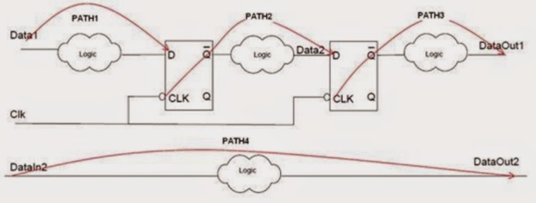
Timing Analysis is performed by splitting the design into different paths based on: Start Points & End points => Timing paths
Calculation of the propagation delay along each path:
STA calculates the delay along each timing path by determining the Gate delay and Net delay.

Slide 38
Gate delay:
  Input transition time
  Output load capacitance
Net delay:
  Parasitic capacitance
  Resistance if net

Slide 39
Why clocks
Means to synchonize
By allowing events to happen at known timing boundaries, we can sequence these events

Slide 40
FF
FF
Synchronous design = combinational logic + sequential elements
Q
combinational
logic
D
CLK
CLK
T_{max} : longest data propagation path delay
T_{min} : shortest data propagation path delay
DATA
T_{cycle}
T_{hold}
T_{setup}

Slide 41
Timing correction
Timing driven placement
Timing driver routing
Buffering
sizing

Slide 42
Reducing crosstalk effect
The longest path among all input-output pairs is usually called the critical path.
STA compute path propagation

Slide 43
http://www.ee.ncu.edu.tw/~jfli/vlsi21/lecture/ch00.pdf
http://www.engr.uconn.edu/~tehrani/teaching/test/
http://ece-research.unm.edu/jimp/vlsi_test/slides/
http://www.groupes.polymtl.ca/ele6306/pages/cours.php
design for testability in vlsi

Slide 44
Digital Systems Testing and Testable Design
Essentials of Electronic Testing
For Digital, Memory and Mixed-
Signal VLSI Circuits
Michael L. Bushnell
Vishwani D. Agrawal
Kluwer Academic Publisher
Boston/ Dordrecht/London

